Slide 1
CSCE 5300 Project
The Predictive Analysis of Crop Recommendation using HADOOP and BIG DATA Submitted By - Group 8
Team Members:
1.Aditya Naga Venkatakrishna Chaitanya Kandregula 1161877
2.Anirudha Kulakarni Karanam 11656382
3.Mahaboob Ali Chisti Shaik 11647519
4.Surya Vamsi Chintapalli 11645442

Slide 2
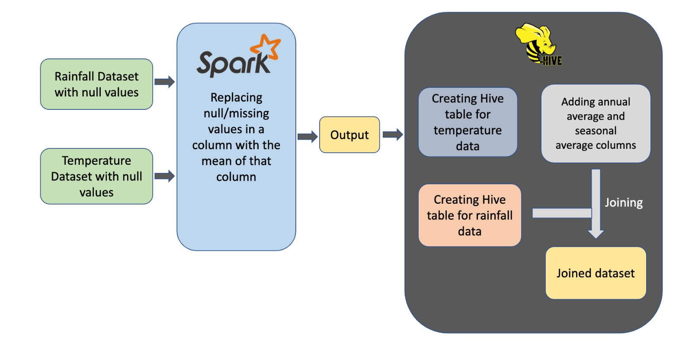

Slide 3


Architecture
DATA COLLECTION
DATA CLEANING
DATA PROCESSING
Data Clean up and eliminating the null values and unwanted values
Using spark we have removed the null values present in Temperature and Rainfall datasets.
By using the data we have processed the data from Excel sheet to Hive and processed and joined the data using Queries.
In the Primary stage we are collecting the raw data.
RESULTS
In the End we got results by joining the Temperature and rainfall datasets.

Slide 4
Methodology
Data Cleaning
Data Processing
Data Visualisation

Slide 5

Methodology
DATA CLEANING:-
Data cleaning is a process to ensure that data is accurate, consistent while minimizing errors and inconsistencies that may arise from data entry.
Data Cleaning involves various tasks such as:-
Removing duplicate records.
Handling missing or null values by imputing or removing them.
Resolving inconsistencies between related datasets.
Standardizing data formats or units.

Slide 6
Methodology
In our project we have used Apache Spark to clean our data because Apache Spark is a tool used for data cleaning which improves our efficiency and scalability so that it will be easier to do our tasks when handling with large datasets.
DATA PROCESSING:- It involves different techniques and tools depending on the nature and complexity of the data and converts raw data into a usable format that can be analysed. For example, data processing for structured data may involve using SQL, while data processing for unstructured data may involve using machine learning algorithms.

Slide 7
Methodology
We have used Hive for data processing. Hive is a tool used for data processing large datasets using SQL queries.
It is also easier to load the data in Hive compared other data processing tools.
DATA VISUALISATION:- It is the process of representing data in a visual format, such as charts, graphs or maps to helps users understand and analyse complex data.
We have done our data visualisation in Excel spreadsheet because it is easy to use, accessible and widely adopted.

Slide 8
Methodology
We have used 3D bar graph in our rainfall and temperature datasets. A 3D bar graph is a type of chart that uses rectangular bars or columns to represent data in three dimensions.
The height of each bar or column represents a numerical value, while the width and depth represents categories or groups. In a 3D bar graph each bar is plotted along three axes: x-axis, y-axis and z-axis. The x-axis and y-axis represents the two categorical variables being compared while the z-axis represents the numerical variable being measured.
From rainfall dataset x-axis represents years, y-axis represents rainfall and the z-axis represents months.

Slide 9
Features
Temperature: As mentioned in the objectives, the temperature could affect the growth of the crop, so this could be measured and used as a feature.
Rainfall: The amount of rainfall could be measured and used as a feature, as this is important for determining the suitability of the environment for the crop.
Location: The location where the crop is being grown could also be considered as a feature, as different regions may have different ideal conditions for crop growth.
Recommendation Dataset : At last, we are obtaining the values of temperature and rainfall We are comparing them with the Crop Recommendation Dataset.
Year : We have taken this to collect annual average Temperature and Rainfall values.
T average: By using Temperature average feature we are obtaining month wise average Data.
7.SUBDIVISION: In this feature we are describing the area or a particular Region.
8.Annual : By using this we can collect all month's data by averaging the values.
9.Seasonal Average : By using this we are able to extract the average Rainfall for each quarter.

Slide 10
Hive, Spark, and HDFS are all tools used in the field of big data and data processing.
Hive
is a Hadoop data warehouse and SQL-like query language tool for managing and analyzing structured and semi-structured data. It provides data analysts with a familiar interface and enables SQL-like queries, allowing them to access, manipulate, and analyze data using SQL-like syntax.
By using our data, we have Processed the data from excel sheet to table.
Temperature data set is processed from excel sheet to the table By using some of the queries we have added the annual season wise data added
Spark is a free and open-source data processing engine that enables distributed and fast data processing. It offers a unified engine that can handle a variety of workloads such as batch processing, real-time processing, machine learning, and graph processing.
Data cleanup
In the excel sheet there are null values by using Spark we can remove the null values and it used for processing .
We have removed the null values in the temperature and rainfall.

Slide 11
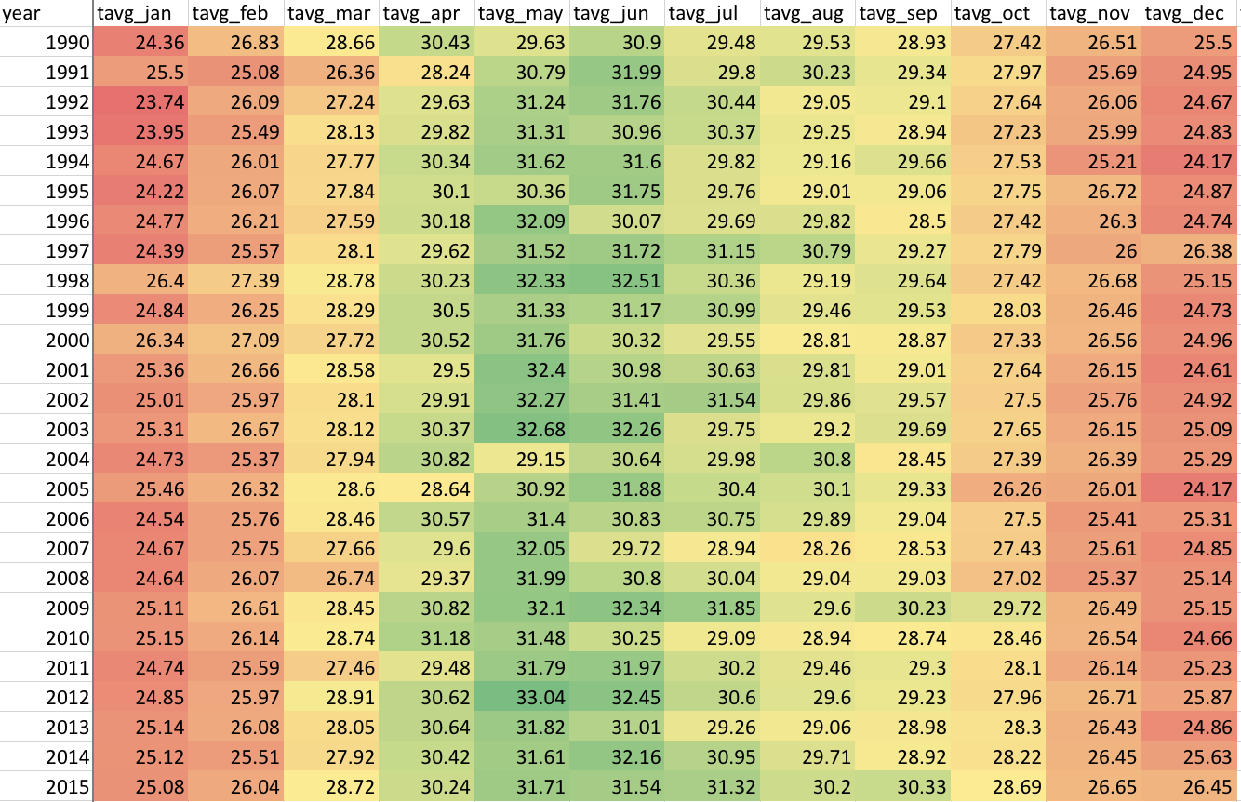
Heatmap of monthly temperature data

Slide 12
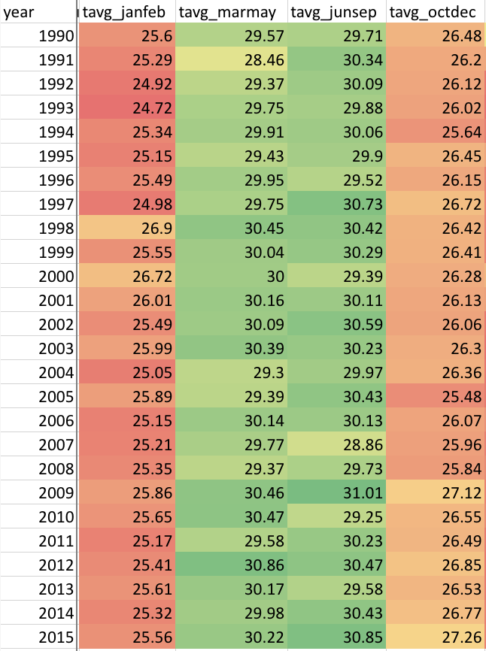
Heatmap of seasonal temperature data

Slide 13
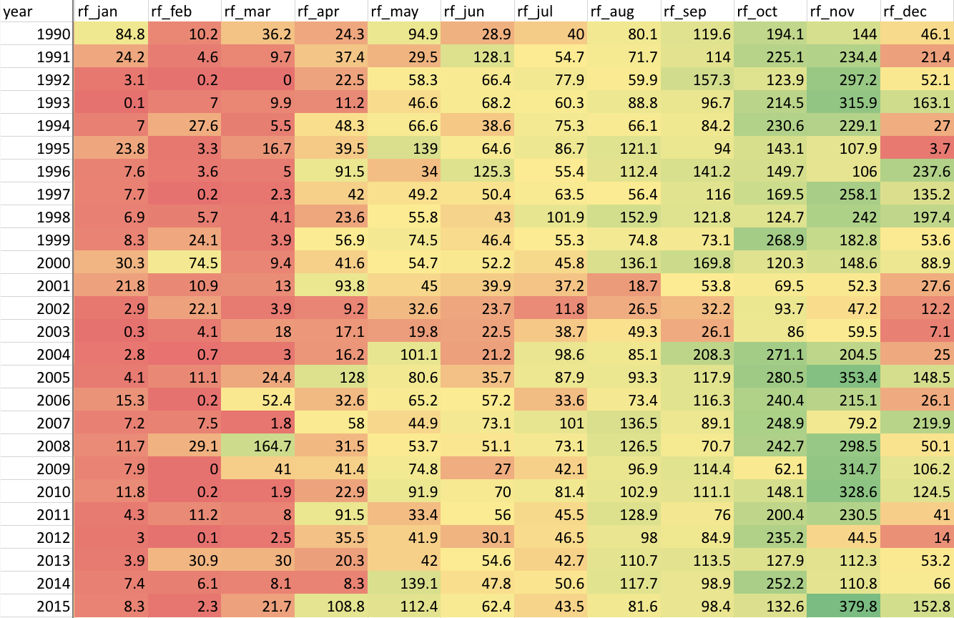
Heatmap of monthly rainfall data

Slide 14
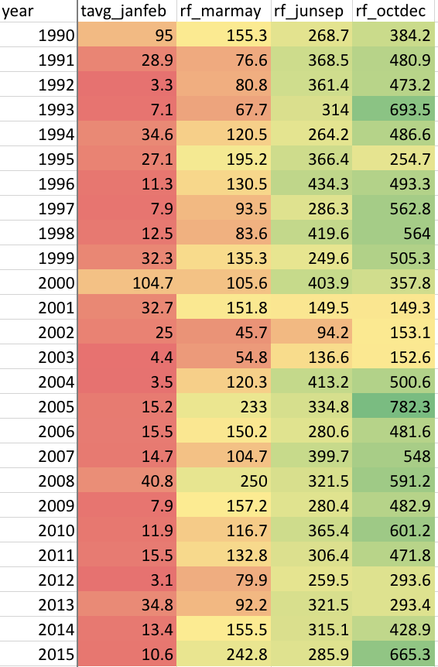
Heatmap of seasonal rainfall data

Slide 15
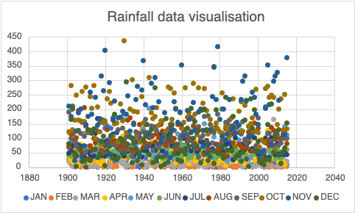
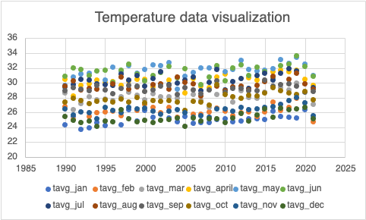
X axis Represents: years
Y axis Represents: Average Rainfall
November and is low from February to June.
Visualization of rainfall data as scattered chart
X axis Represents : years
Y axis Represents: AverageTemperature
Visualization of temperature data

Slide 16
Project – part 2

Slide 17
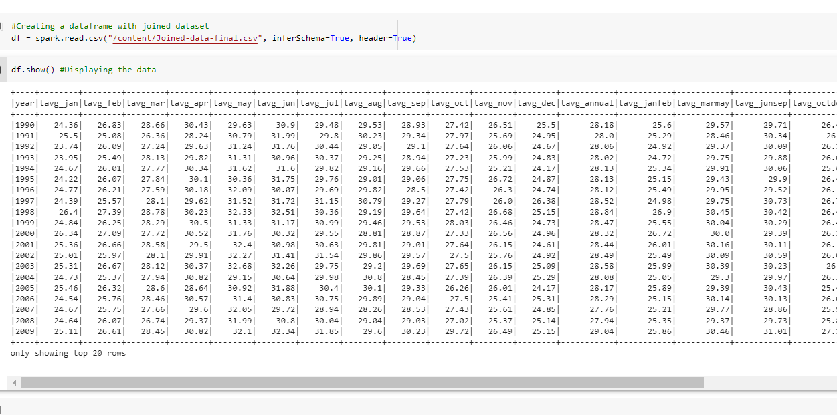
Now we are Displaying The Data.

Slide 18
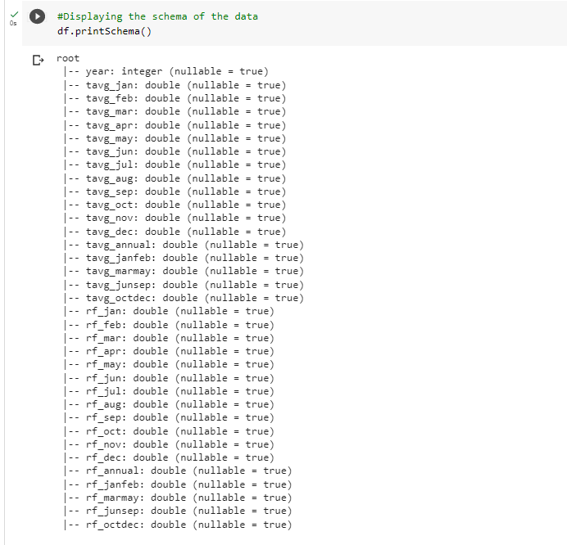
Displaying the Schema of the Data

Slide 19
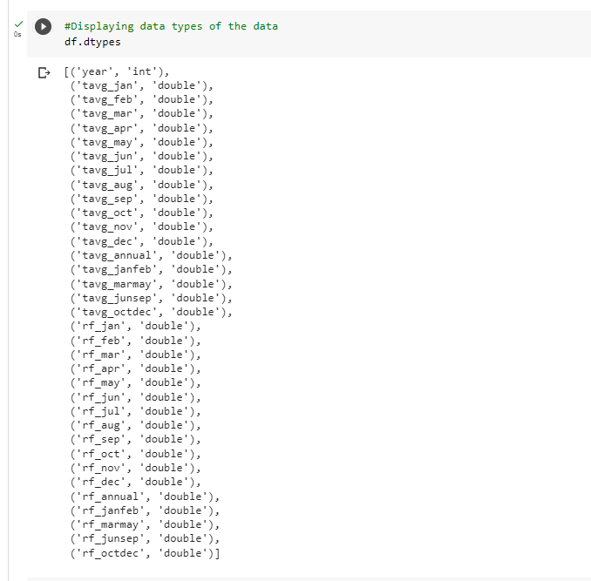
Displaying Data types of the Data

Slide 20
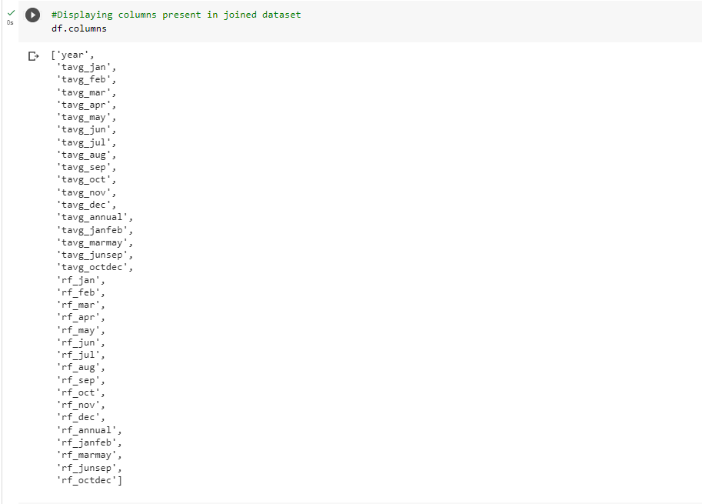
Displaying the columns present in joined Dataset

Slide 21
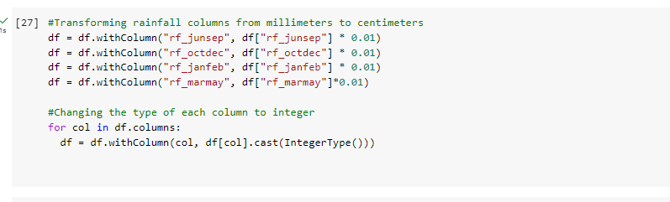
We are Transforming the rainfall column from millimeters to Centimeters

Slide 22
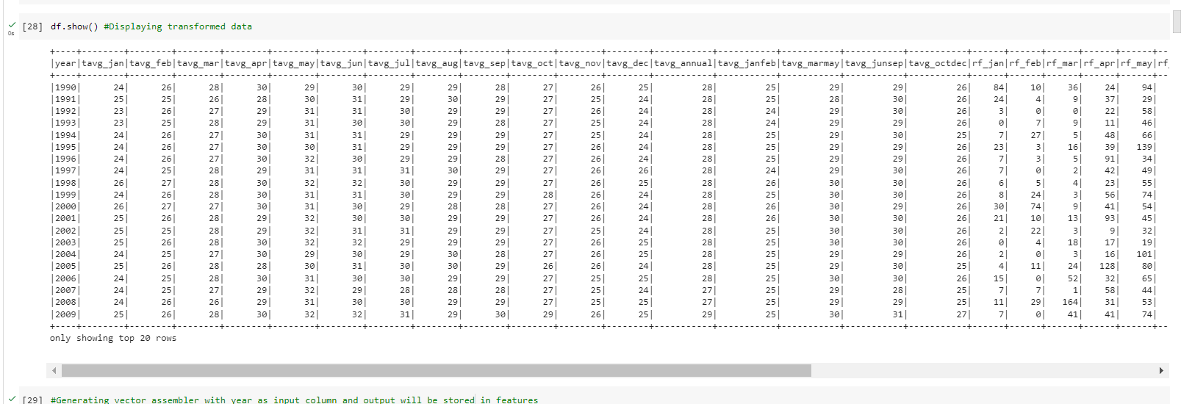
Now Displaying the Transformed Data

Slide 23
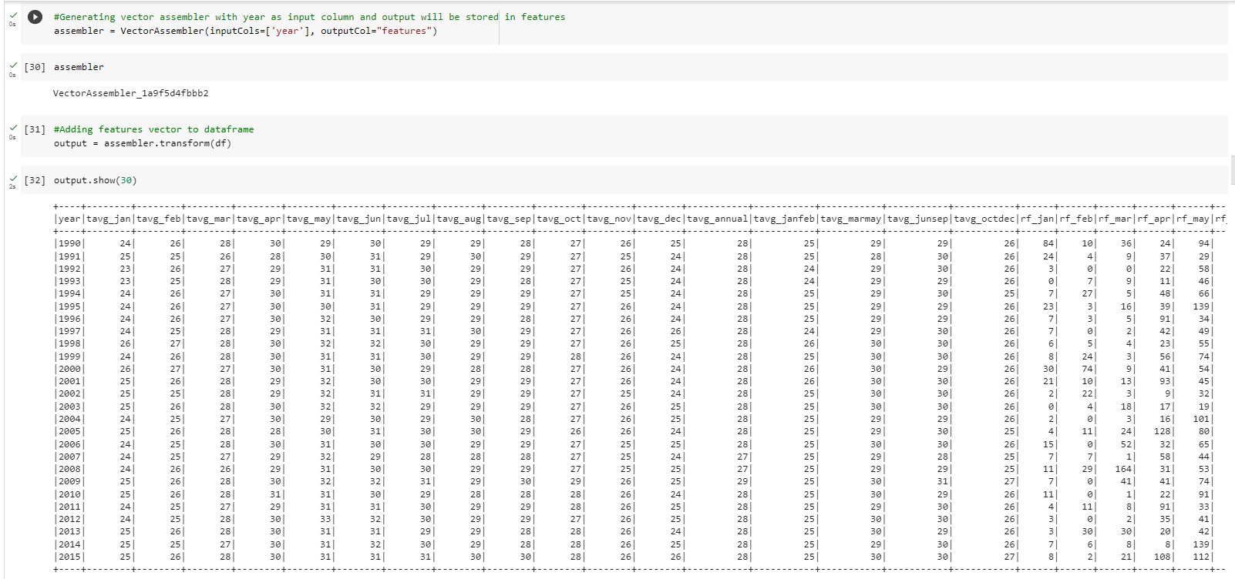
Adding Features vector to Data frame

Slide 24
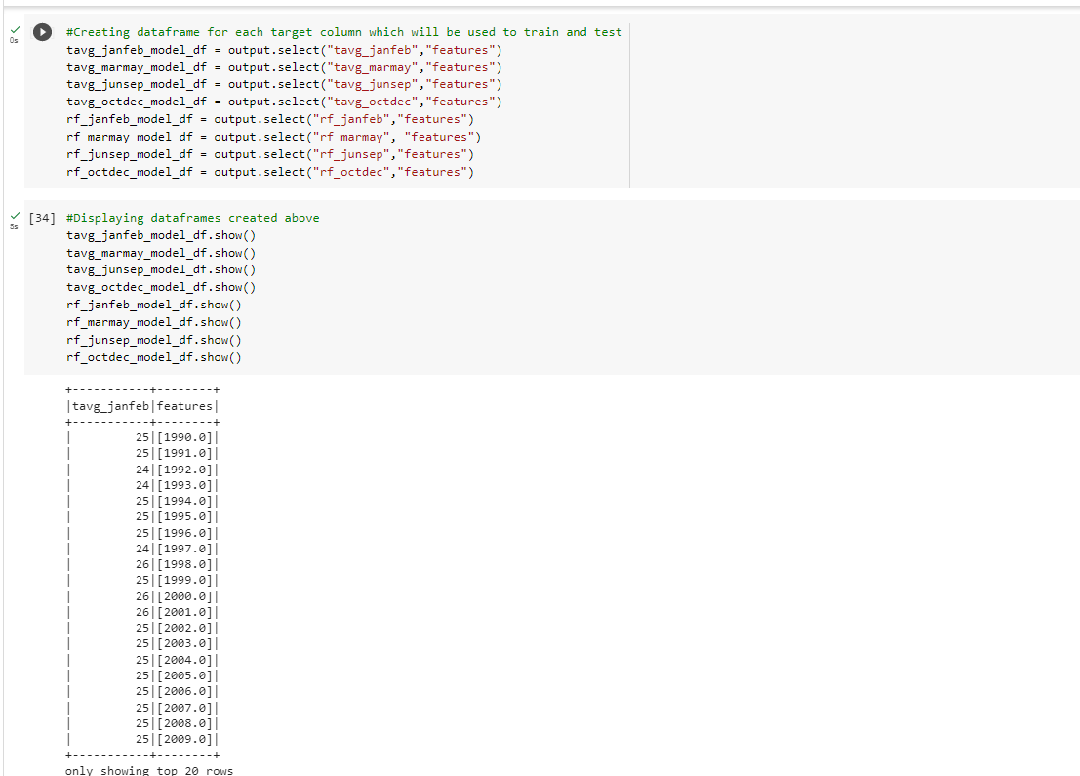
Creating Data frames and Displaying

Slide 25
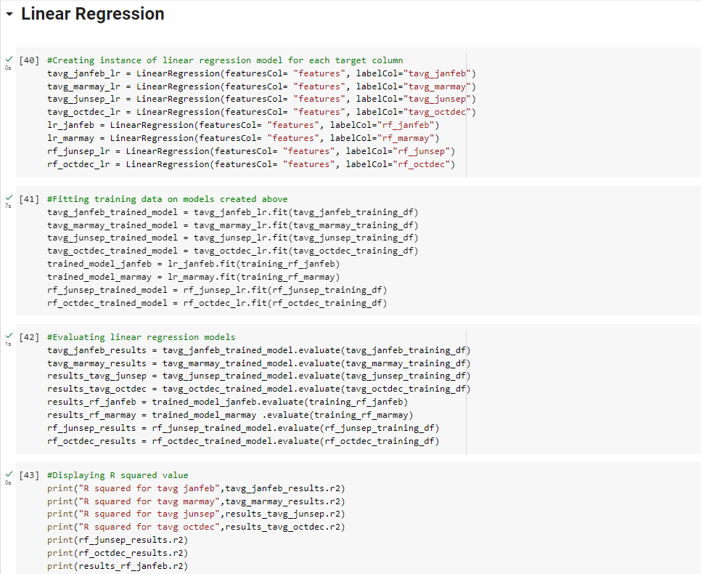

Slide 26
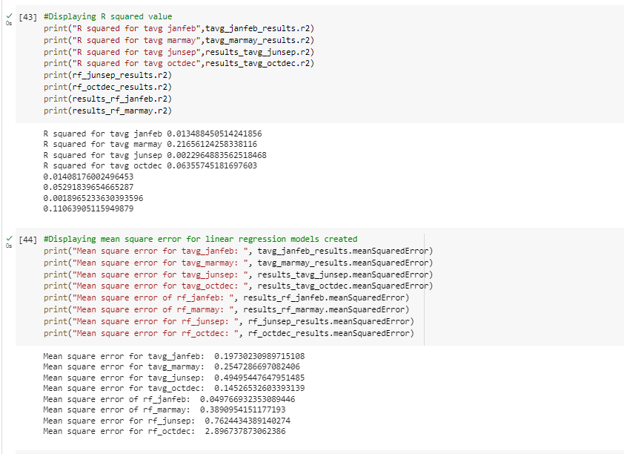

Slide 27
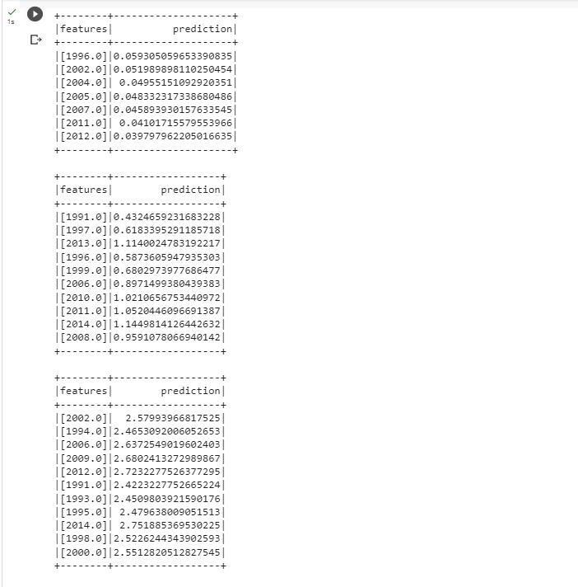

Slide 28
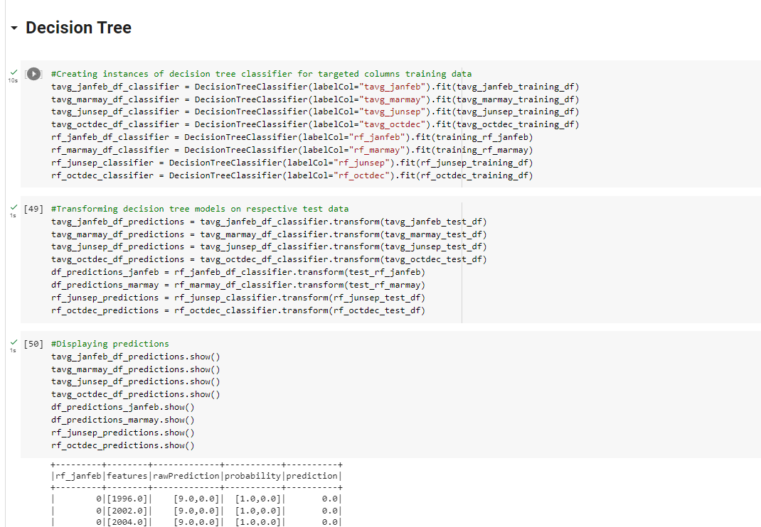

Slide 29
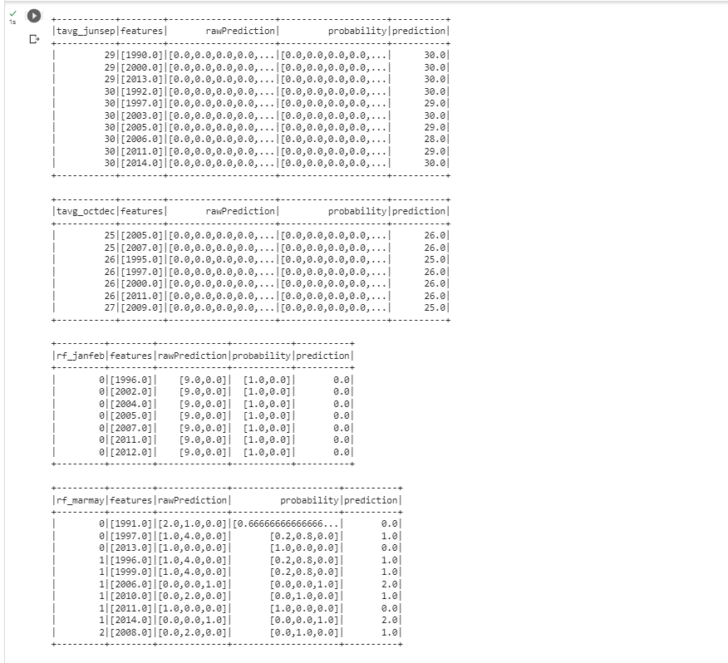
Prediction Values:

Slide 30
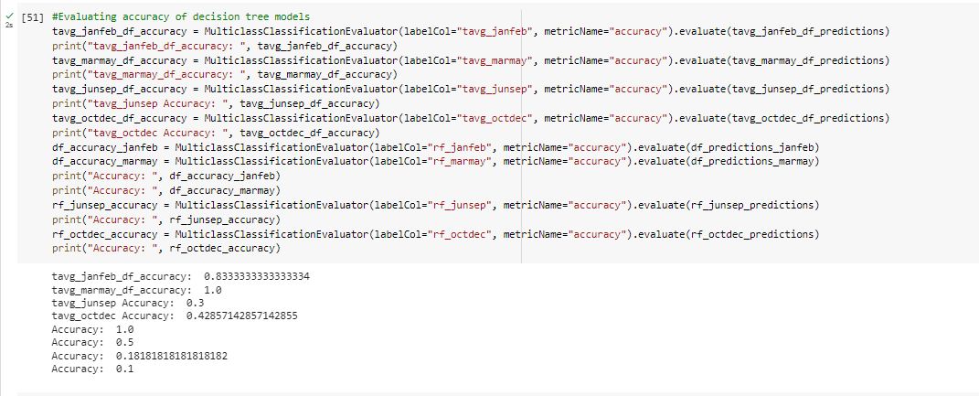
Evaluating the Accuracy of Decision Tree models

Slide 31
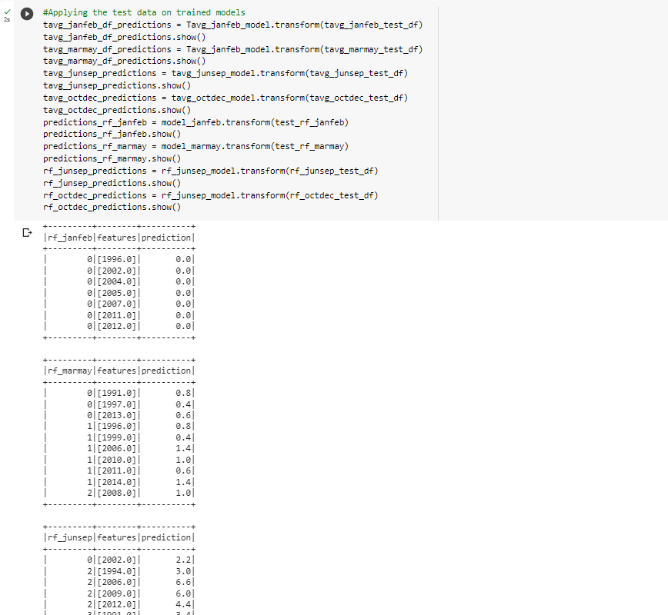

Slide 32
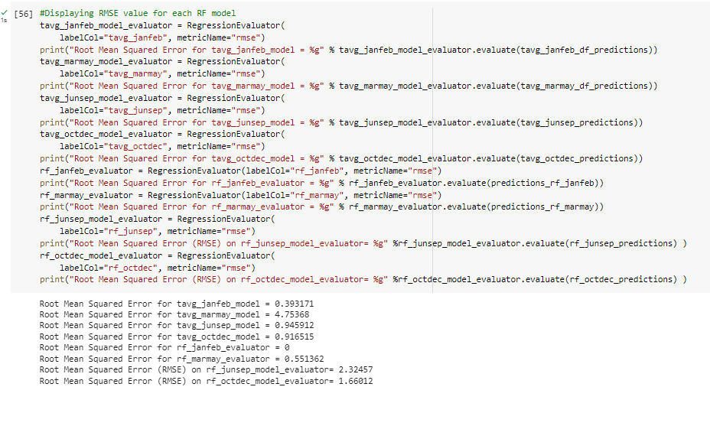
Displaying the Rise Value for Each RF Model

Slide 33
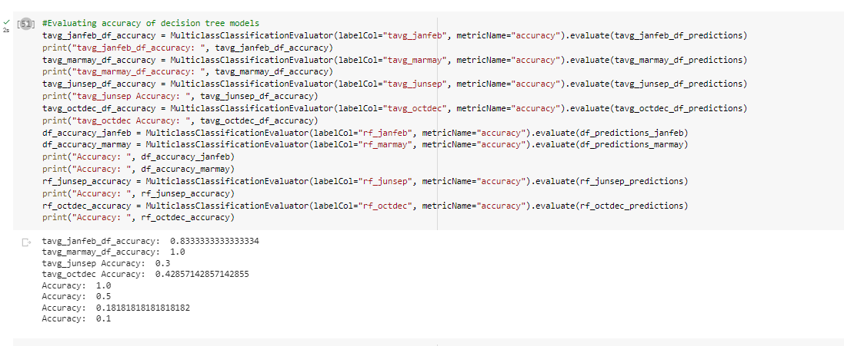
Accuracy Results

Slide 34
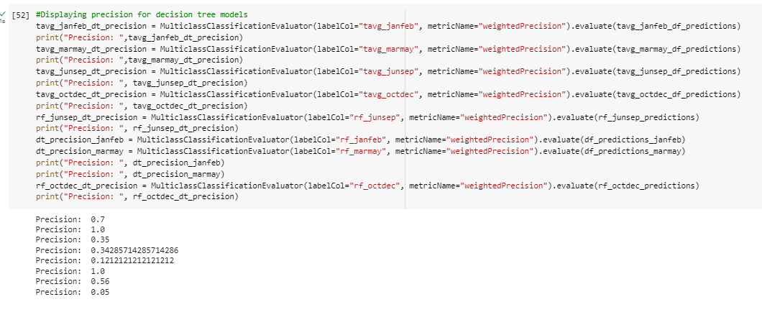
Precision Results

Slide 35
THANKS

